Slide 1

Spain’s Electricity Shortfall
data Analysis on The expansion of Spain’s shortfall between the energy generated by means of fossil fuels and various renewable sources

Slide 2

ContentS
Problem statement
Data Analysis
Data engineering
Modelling
Model Performance
Conclusion

Slide 3
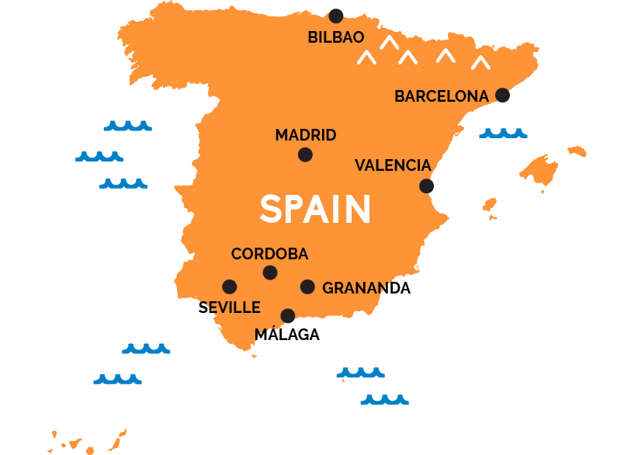
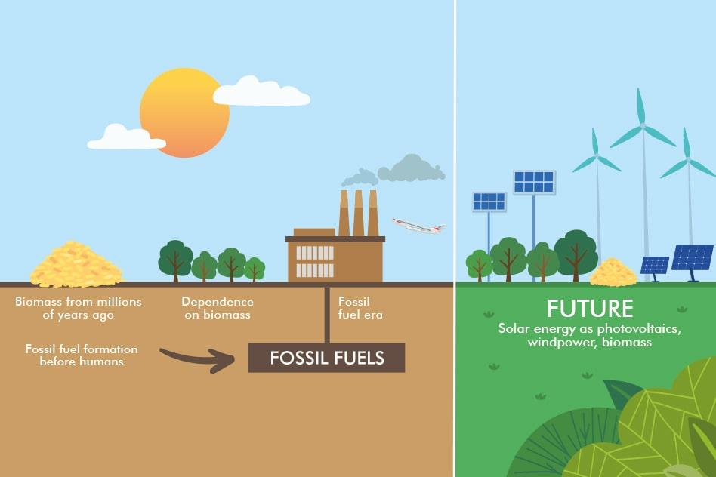
PROBLEM Statement
We have been tasked with building a model showcasing the shortfall between the energy generated by means of fossil fuels and various renewable sources - for the country of Spain. The daily shortfall, will be modelled as a function of various city-specific weather features such as pressure, wind speed, humidity, etc. The provided features are rarely adequate predictors of the target variable. As such, we are required to build a model to accurately predict Spain's three hourly shortfalls.

Slide 4

Exploratory data analysis
Weather Attributes
Wind (speed, direction)
Temperature
Pressure
Rainfall
Humidity
Snow
Cloud cover
Time(year,month,day)

Slide 5
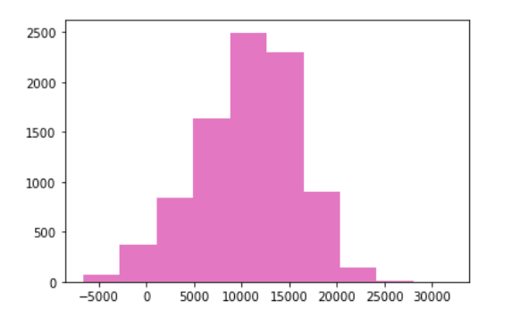
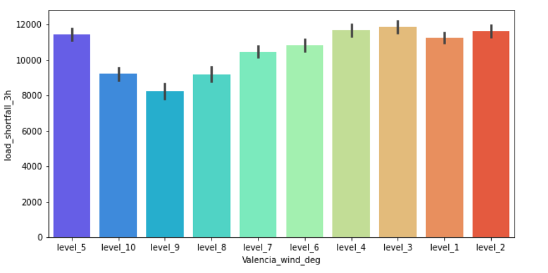
Exploratory data analysis
Feature Distributions
Histogram showing 3 hourly shortfall
Barplot showing the interaction between the Wind degree & 3 hourly shortfall

Slide 6
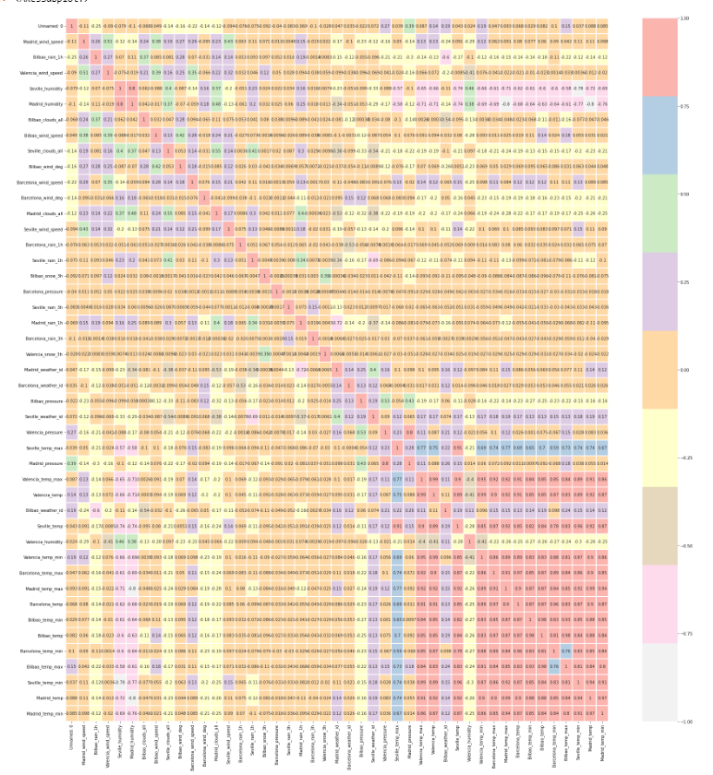
Exploratory data analysis
Feature Distributions
Heatmap to evaluate correlation of features.

Slide 7
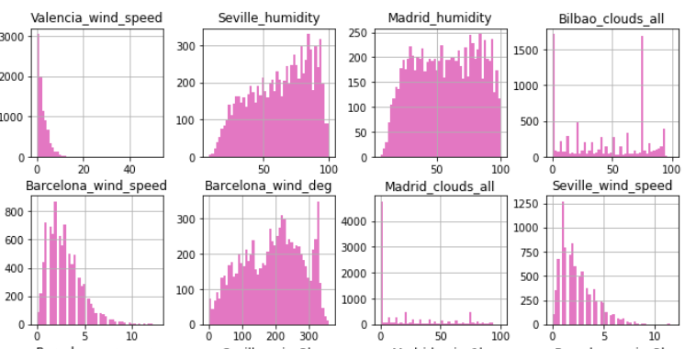
Exploratory data analysis
Feature Distributions
Histograms examining features
based on the datasets provided

Slide 8


Data/Feature Engineering
Check and remove missing values/features
Check if null values have been replaced
Created new features
Engineer & transform existing features
Scaling the dataset

Slide 9
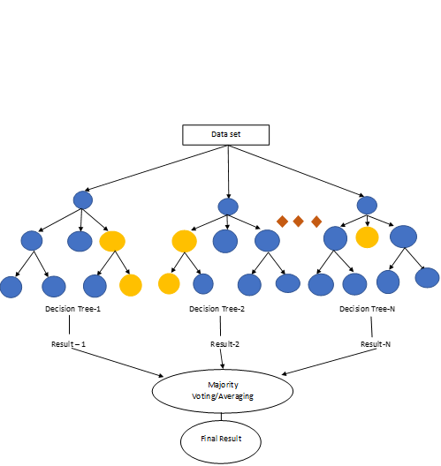
Modelling
Random Forest
It builds decision trees on different samples and takes their majority vote for classification and average in case of regression.

Slide 10

Modelling
Decision Tree
A decision tree is a supervised learning algorithm, which is utilized for both classification and regression tasks. It has a hierarchical, tree structure, which consists of a root node, branches, internal nodes and leaf nodes.

Slide 11
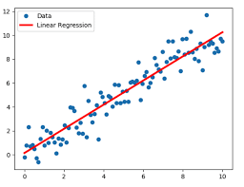
Modelling
Linear Regression
Linear regression analysis is used to predict the value of a variable based on the value of another variable. The variable you want to predict is called the dependent variable. The variable you are using to predict the other variable's value is called the independent variable.

Slide 12
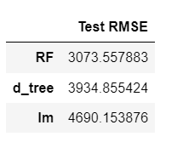
Model Performance
RMSE Outcomes
As per the Model performance Test above , The Random forests model is the best performing model as it is great with high dimensional data and provides the highest accuracy. The random forest technique can also handle big data with numerous variables.
Random Forests are faster to train than decision trees
A random forest produces good predictions that can be understood easily.
The Random forest algorithm avoids and prevents overfitting by using multiple trees.

Slide 13

Conclusion
Outcomes :
To analyse Spain’s electricity shortfall due to reduced supply by renewable sources by analysing weather attributes.
Utilize data analysis & machine learning principles to predict future shortfalls
Developed a predictive model that can be used to determine shortfalls.

Slide 14

QUESTIONS

